Slide 1
Topic: Integers?
EQ: How do we use patterns of tens and ones in a hundreds chart?
Get your VIVO’s
Topic and EQ in Interactive Notebook
NO PHONES OR EAR BUDS
Have a go:
Put hardcopy of math space sheet in library section. Check your mark
Complete on working out side:
1. What number is halfway between -1 and -13
2. What number is halfway between 7 and -19
Notes:
-1+-13= -14/2=-7
7+-19= -12/2=-6

Slide 2
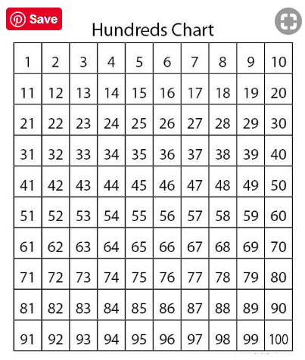
24
7
30
Date
Integers
EQ: How do we use patterns of tens and ones in a hundreds chart?
Our number system is “base ten” which means that we work in multiples of ten
5

Slide 3
24
7
30
Date
Integers
EQ: How do we use patterns of tens and ones in a hundreds chart?
Work on “Extending Patterns in Hundreds Chart”worksheet
Early finishers:
1. Write the 4 missing numbers
 | 30
2. Complete “One in a million” worksheet. Don’t do the Activity questions with the cards
5

